Slide 1



Deep Learning Design Patterns with Tensorflow 2.x
Computer Vision Workshop - Data Pipeline #2 Version: May 2020
Repo: github.com/GoogleCloudPlatform/keras-idiomatic-programmer
twitter.com/andrewferlitsch

Slide 2
Data Pipelines
Overview
We will cover in this section we will cover data pipeline part of a e2e production pipeline
Data Formats and Storage [1st session]
Data Feeding [1st session]
Data Preprocessing
Data Augmentation

Slide 3
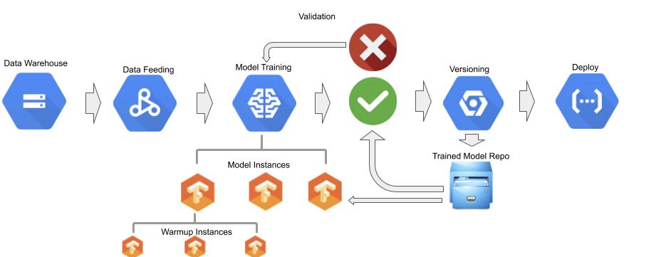
e2e Pipeline

Slide 4
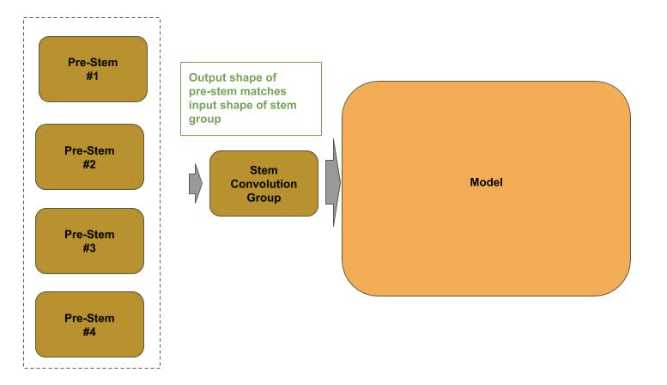
Preprocessing - using a Pre-Stem
One of the recommendations when TF 2.0 was released was to move preprocessing into the graph. We do this with a pre-stem. The approach I recommend is make it independent of the model but be plug-n-play such that the preprocessing occurs on the graph and can be interchangeable.

Slide 5
Pre-Stem Requirements
Pre-stems have two requirements to be plug-n-play with existing models, trained and untrained:
The output from the pre-stem must match the input from the model.
The input shape for the pre-stem must match the input source, whether for training or prediction.

Slide 6
Pre-Stem Types
Plug-n-play pre-stems generally fall into two types:
Stays with the model after deployment for prediction. For example, the pre-stem does resizing and normalization of the input source.
Used on during training, and not used after deployment. For example, the pre-stem did random image augmentation for learning translational and scale invariance during training.

Slide 7
Pre-Stem Types
Plug-n-play pre-stems generally fall into two types:
Stays with the model after deployment for prediction. For example, the pre-stem does resizing and normalization of the input source.
Used on during training, and not used after deployment. For example, the pre-stem did random image augmentation for learning translational and scale invariance during training.

Slide 8
TF.Keras Preprocessing Layers
TF.Keras 2.2 introduced new layers for preprocessing. We will cover three of them in this section:
Rescaling
Resizing
CenterCrop
In the next slide I show a plug-n-play pre-stem that we add to an existing model prior to training.

Slide 9
TF.Keras Preprocessing Layers - Existing Model
Create an untrained ConvNet with two convolutional (Conv2D) layers of 16 and 32 filters, respectively.
Then flatten (Flatten) the feature maps into a 1D vector, without dimensionality reduction, as the bottleneck layer.
Then the final Dense layer for classification.
from tensorflow.keras.layers.experimental.preprocessing import Rescaling model = Sequential() model.add(Conv2D(16, (3,3), strides=1, padding='same', input_shape=(32, 32, 3))) model.add(BatchNormalization()) model.add(ReLU()) model.add(Conv2D(32, (3,3), strides=1, padding='same')) model.add(BatchNormalization()) model.add(ReLU()) model.add(Flatten()) model.add(Dense(10, activation='softmax'))

Slide 10
TF.Keras Preprocessing Layers - Wrapper Model
The wrapper will consist of two parts: the pre-stem, and the untrained ConvNet model.
For the pre-stem, we add the preprocessing layer Rescaling to normalize the integer pixel data between floating point values 0 and 1.
Since the pre-stem will be the input layer in the wrapper model, we add the parameter input_shape=(32, 32, 3)) to specify the input shape. Since Rescaling does not change the size of the input, the output from the pre-stem matches that of the input to the model.
wrapper = Sequential() wrapper.add(Rescaling(scale=1.0/255, input_shape=(32, 32, 3))) wrapper.add(model) wrapper.compile(loss='sparse_categorical_crossentropy', optimizer='adam', metrics=['acc'])

Slide 11
TF.Keras Preprocessing Layers - Resizing
An implementation of a plug-n-play pre-stem that performs two functions: resizes the input and normalizes the pixel data.
Create the wrapper model with two preprocessing layers:
Image resizing (Resizing)
Normalization (Rescaling).
The input to the ConvNet is of shape (28, 28, 3). We use a pre-stem to resize an input from (32, 32, 3) to (28, 28, 3) to match the ConvNet and normalize the pixel data.
wrapper = Sequential() wrapper.add(Resizing(height=28, width=28, input_shape=(32, 32, 3)) wrapper.add(Rescaling(scale=1.0/255)) wrapper.add(model) wrapper.compile(loss='sparse_categorical_crossentropy', optimizer='adam', metrics=['acc'])

Slide 12
Pre-Stem Tear Off
After the model is trained, we can remove the pre-stem and use the model for inference.
In this example, we assume that the image test data is already sized (28, 28, 3) to match our ConvNet, and we normalize the pixel data upstream from the model.
The first two layers of the wrapper model are the pre-stem, which means our underlying trained model starts at the 3rd layer; hence will we set the model to wrapper.layers[2]. Now we can do inference with the underlying model without the pre-stem.
x_test = (x_test / 255.0).astype(np.float32) model = wrapper.layers[2] model.evaluate(x_test, y_test)

Slide 13
Pre-Stem - Chaining
The first pre-stem is used for training and then removed for inference, and the second one stays with the model.
In the first (inner) pre-stem, we do normalization of the integer pixel data (Rescaling).
In the second (outer) pre-stem we do center cropping (CenterCrop) of the input images for training. We also set the input size to the second pre-stem to be any height and width (None, None, 3). As a result, we can feed during training images of different sizes to the second pre-stem and it will center crop them to (32, 32, 3), which is then passed as the input to the first pre-stem, which does the normalization.
Finally, when trained, we remove the second (outer) pre-stem and do inference without the center cropping.
wrapper1 = Sequential() wrapper1.add(Rescaling(scale=1.0/255)) wrapper1.add(model) wrapper1.compile(loss='sparse_categorical_crossentropy', optimizer='adam', metrics=['acc']) wrapper2 = Sequential() wrapper2.add(CenterCrop(height=32, width=32, input_shape=(None, None, 3))) wrapper2.add(model) wrapper2.compile(loss='sparse_categorical_crossentropy', optimizer='adam', metrics=['acc']) wrapper2.fit(x_train, y_train, epochs=5, batch_size=32, verbose=1) wrapper2.layers[1].evaluate(x_test, y_test)

Slide 14
Pre-Stem - Layer Subclassing
Alternatively, one can create your own custom preprocessing layers using layer subclassing. All the predefined layers in TF.Keras are subclassed from the TF.Keras.Layer class. To create your own custom layer, you need to:
Create a class that subclasses (inherits) the TF.Keras.Layer class.
Override the initializer __init__, build and call methods.

Slide 15
Pre-Stem - Layer Subclassing
__init__(): Add layer specific (custom) parameters. For Rescaling, we added the parameter scale.
build(): Takes the parameter input_shape which specifies the input shape to the layer. The parameter self.kernel sets the shape of the kernel for the layer Since rescaling has no learnable parameters, we set it to None.
call(): Invoked when the graph is executing: training or inference. Takes as a parameter inputs, which is the input tensor to the layer and the method returns the output tensor. In our case, we will multiple each pixel value in the input tensor by the scale factor set when the layer was initialized, and output the rescaled tensor.
from tensorflow.keras.layers import Layer class Rescaling(Layer): """ Custom Layer for Preprocessing Input """ def __init__(self, scale, input_shape=None, name=None): """ Constructor """ super(Rescaling, self).__init__(input_shape=input_shape, name=name) self.scale = scale def build(self, input_shape): """ Handler for building the layer """ self.kernel = None @tf.function def call(self, inputs): """ Handler for layer object is callable """ inputs = inputs * self.scale return inputs
We add the decorator @tf.function to tell TensorFlow AutoGraph to convert the Python code in this method to graph operations in the model.

Slide 16
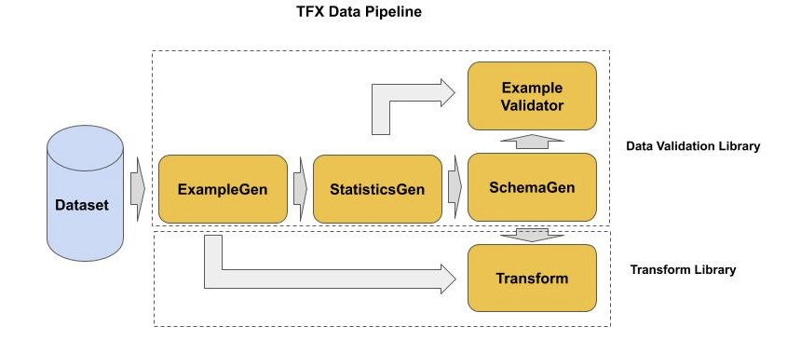
Preprocessing with TF Extended (TFX)
Tensorflow Serving (TFX) is a e2e production pipeline. In this section, we cover the data pipeline portion of TFX.

Slide 17
TFX Components
Components:
ExampleGen - ingests data from a dataset source.
StatisticsGen - analyzes the examples from the dataset and produces statistics on the dataset distribution.
SchemaGen - derives a data schema from the dataset statistics (feature types, etc).
ExampleValidator - monitors the training and serving data for anomalies.
Transform - does data transformations, such as feature engineering, data preprocessing and data augmentation.
from tfx.utils.dsl_utils import external_input from tfx.components import ImportExampleGen from tfx.components import StatisticsGen, SchemaGen, ExampleValidator, Transform from tfx.orchestration.experimental.interactive.interactive_context import InteractiveContext

Slide 18
TFX ExampleGen
Before we can execute a TFX pipeline, we have to setup the orchestration. For our purposes, we will use an interactive context.
context = InteractiveContext()
ExampleGen is the entry point into the TFX pipeline. It’s purpose is to draw batches of examples from a dataset. It supports a wide variety of dataset formats, including: CSV files, TFRecords and Google BigQuery. The output from ExampleGen are tf.Example records.
Use ExampleGen for a dataset on-disk in TFRecord format (e.g., images). It consists of two steps.
Step 1: define a connector to the input source. Since the input source is TFRecords, we use the TFX utilities method external_input() to map a connector between the TFRecords on disk and our instance of ImportExampleGen.
Step 2: instantiate the ExampleGen component as subclass ImportExampleGen, where the initializer takes as a parameter the input source for the examples (input=examples).
examples = external_input('tfrec') example_gen = ImportExampleGen(input=examples) context.run(example_gen)

Slide 19
TFX StatisticsGen
The StatisticsGen component generates dataset statistics from an input source of examples. These examples can either be that of the training/evaluation data or the serving data.
Instantiate an instance of StatisticsGen(), and pass to the initializer the source of the examples.
The source for the examples is the output from our example_gen instance in the previous code example.
The output is specified via the ExampleGen property outputs, which is a dictionary, for the key/value pair ‘examples’.
statistics_gen = StatisticsGen(examples=example_gen.outputs['examples']) context.run(statistics_gen) statistics_gen.outputs['statistics']._artifacts[0]

Slide 20
TFX SchemaGen
The SchemaGen component generates a schema from the dataset statistics.
Instantiate an instance of SchemaGen(), and pass to the initializer the source of the dataset statistics.
The source for the statistics is the output from our statistics_gen instance in the previous code example.
The output is specified via the StatisticsGen property outputs, which is a dictionary, for the key/value pair ‘statistics’.
schema_gen = SchemaGen(statistics=statistics_gen.outputs['statistics']) context.run(statistics_gen) schema_gen.outputs['schema']._artifacts[0]

Slide 21
TFX ExampleValidator
The ExampleValidator component identifies anomalies in a dataset using both the dataset statistics and schema as inputs.
Instantiate an instance of ExampleValidator(), and pass to the initializer the source of the dataset statistics and the schema.
The sources for the statistics and schema are
the output from our statistics_gen instance and schema_gen instances, respectively, in the previous code examples.
example_validator = ExampleValidator( statistics=statistics_gen.outputs['statistics'], schema=schema_gen.outputs['schema']) context.run(example_validator) example_validator.outputs['anomalies']._artifacts[0]

Slide 22
TFX Transform
The Transform components perform the dataset transformations as examples are drawn into batches during training or inference. Dataset transformations are typically feature engineering for structured data, and data preprocessing.
instantiate an instance of Transform(). The initializer takes three parameters, the input source for the examples to transform, the data schema and a user-custom python script to do the transformation (e.g., ‘my_preprocessing_fn.py’).
transform = Transform( examples=example_gen.outputs['examples'], schema=schema_gen.outputs['schema'], module_file='my_preprocessing_fn.py') context.run(transform)

Slide 23
Data Augmentation
Image (Data) Augmentation has had a variety of purposes.
At first, it was seen as a means of extending (adding) to an existing dataset more images to train on by doing some random transformations on the existing images.
Today, we use data augmentation for targeted purposes:
Invariance
Essential Feature Learning
Generalizing to Data Draft

Slide 24
Invariance
Use data augmentation to train the model to be translational, scale and viewport invariant.
We want to recognize objects in an image (or frame in video) regardless of the location in the image (translational), the size of the object (scale), and viewing perspective (viewport).
Image augmentation works by randomly transforming the images in the training data for different translation, scale and viewport. Common practice in ablation studies:
Random Center Crop
Random Flip
Random Rotation
Random Shift

Slide 25
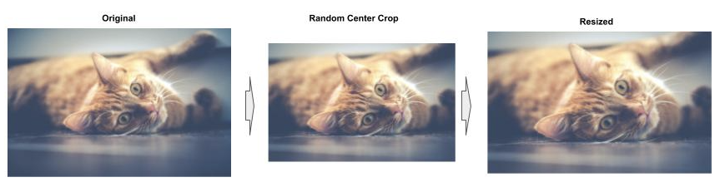
Random Crop
A crop is when we take a portion of the image. Typically a crop is rectangular in shape.
For center crop, the shape of the crop is square and is centered in the original image. The size of the crop randomly varies, so in some instances it's a small portion of the image and others a large portion. The cropped image is then resized to the input size for the model.

Slide 26
Random Flip
A flip is when we flip the image on the horizontal or vertical axis. This transformation contributes to training the model for viewport invariance.
Another thing that random flips contribute to are “learning essential features” of the objects, separated from the background -- regardless of the actual viewport when the model is deployed for real-world predictions.

Slide 27
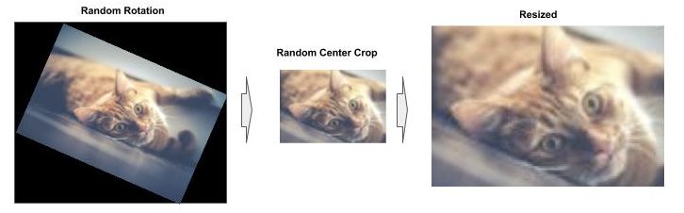
Random Rotation
A rotation is when we rotate the image along the center point.
The common practice for random transformations is to chain them, a range of +/- 90 degrees is sufficient when combined with random flips. This transformation contributes to training the model for viewport invariance.

Slide 28
Random Shift
A random shift is when we shift the image vertically or horizontally. This transformation contributes to training the model for translational invariance.
Shift horizontally: dropping pixels off on either the left or right side and replacing them with the same number of black pixels (no signal) on the opposite side.
Shift vertically: dropping off pixels on either the top or bottom side and replacing them with the same number of black pixels (no signal) on the opposite side.
A general rule of thumb is to limit the shift to no more than +/- 20% of the image width/height to prevent cutting out too much of the object of interest.

Slide 29
Image Transformations - tf.data
Image transformations can be added to a tf.data.Dataset pipeline using the map() method.
In this case, we code the transformation as a Python function, which takes the image as input and outputs the transformed image.
We then specify the function as the parameter to the map() method, which will apply the function to each element in a batch.
def flip(image, label): transform = tf.image.random_flip_left_right(image) transform = tf.image.random_flip_up_down(transform) return transform, label dataset = tf.data.Dataset.from_tensor_slices((x_train, y_train)) dataset = dataset.map(flip)

Slide 30
Image Transformations - tf.data - Chaining
Example of chaining: add a second transformation function to do a random crop. We then chain our two transformations to first do a random flip, followed by a random crop: dataset.map(flip).map(crop).
def crop(image, label): shape = (int(image.shape[0] * 0.8), int(image.shape[1] * 0.8), image.shape[2]) transform = tf.image.random_crop(image, shape) return transform, label dataset = tf.data.Dataset.from_tensor_slices((x_train, y_train)) dataset = dataset.map(flip).map(crop)
Note that the tf.image.random_crop() method is not a center crop. Unlike a center crop which is always centered and the size is random, this Tensorflow method the size is fixed, specified by shape, but the location in the image is random.

Slide 31
Image Transformations - TF.Keras Pre-Stems
The TF.Keras.layers.experimental.preprocessing module provides several preprocessing layers that provide the means to perform image augmentation as a pre-stem component in the model.
Since the pre-stem is plug-n-play, after training is completed, this pre-stem component can be detached prior to deploying the model into production.
In TF 2.2, the preprocessing layers that support translational, scale and viewport invariance are:
CenterCrop
RandomCrop
RandomRotation
RandomTranslation
RandomFlip

Slide 32
TF.Keras Pre-Stems Example
Combine two preprocessing layers for invariance as a plug-n-play pre-stem: RandomFlip() and RandomTranslation().
We create an empty wrapper model, then add the plug-n-play pre-stem, and then add the model.
For deployment, we detach the plug-n-play pre-stem
wrapper = Sequential() wrapper.add(RandomFlip()) wrapper.add(RandomTranslation(fill_mode='constant', height_factor=0.2, width_factor=0.2)) wrapper.add(model)

Slide 33
THANK YOU FOR WATCHING
Google Cloud AI Developer Relations AI Training

Slide 34
Data Pipeline - Lab Exercise #XX
Optional Code Lab - Get Familiar with Data Pipeline #2
Deep Learning Design Patterns - Workshop - Chapter 9 - 2.ipynb

